Slide 1

NASA-MSFC Measurement of Cryogenic Propellant Fuel Levels
Team 516
1

Slide 2

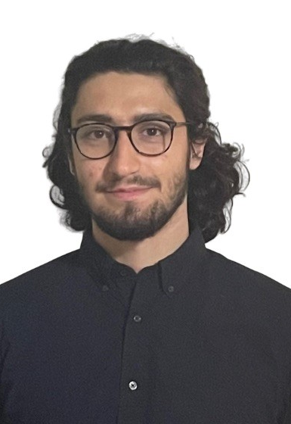
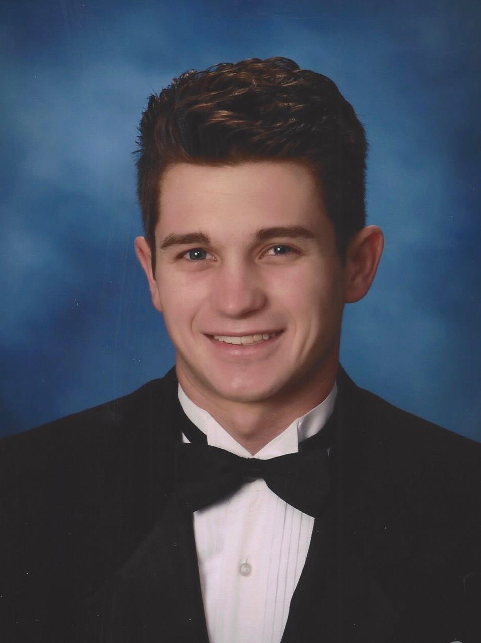
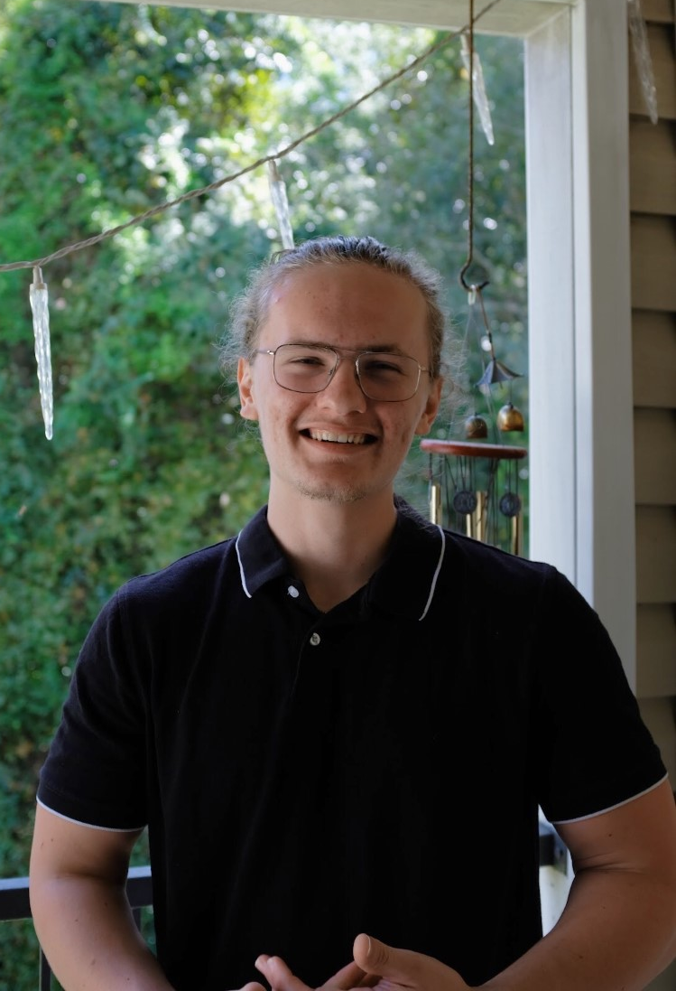
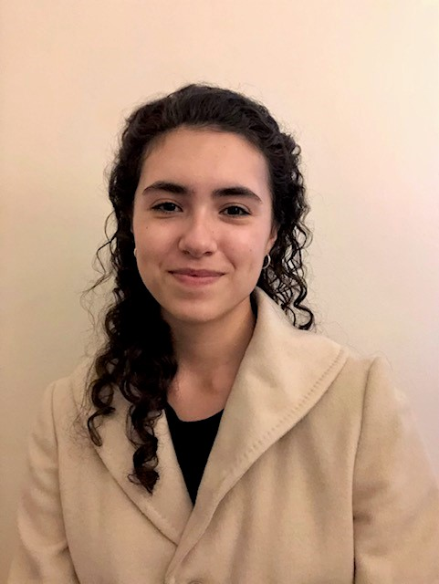
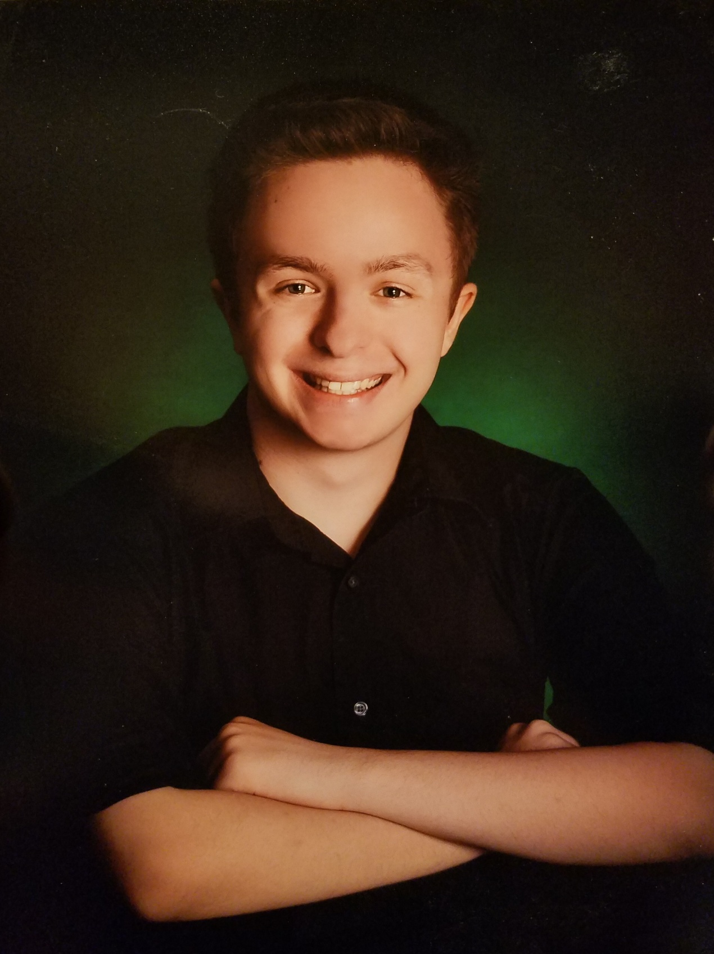
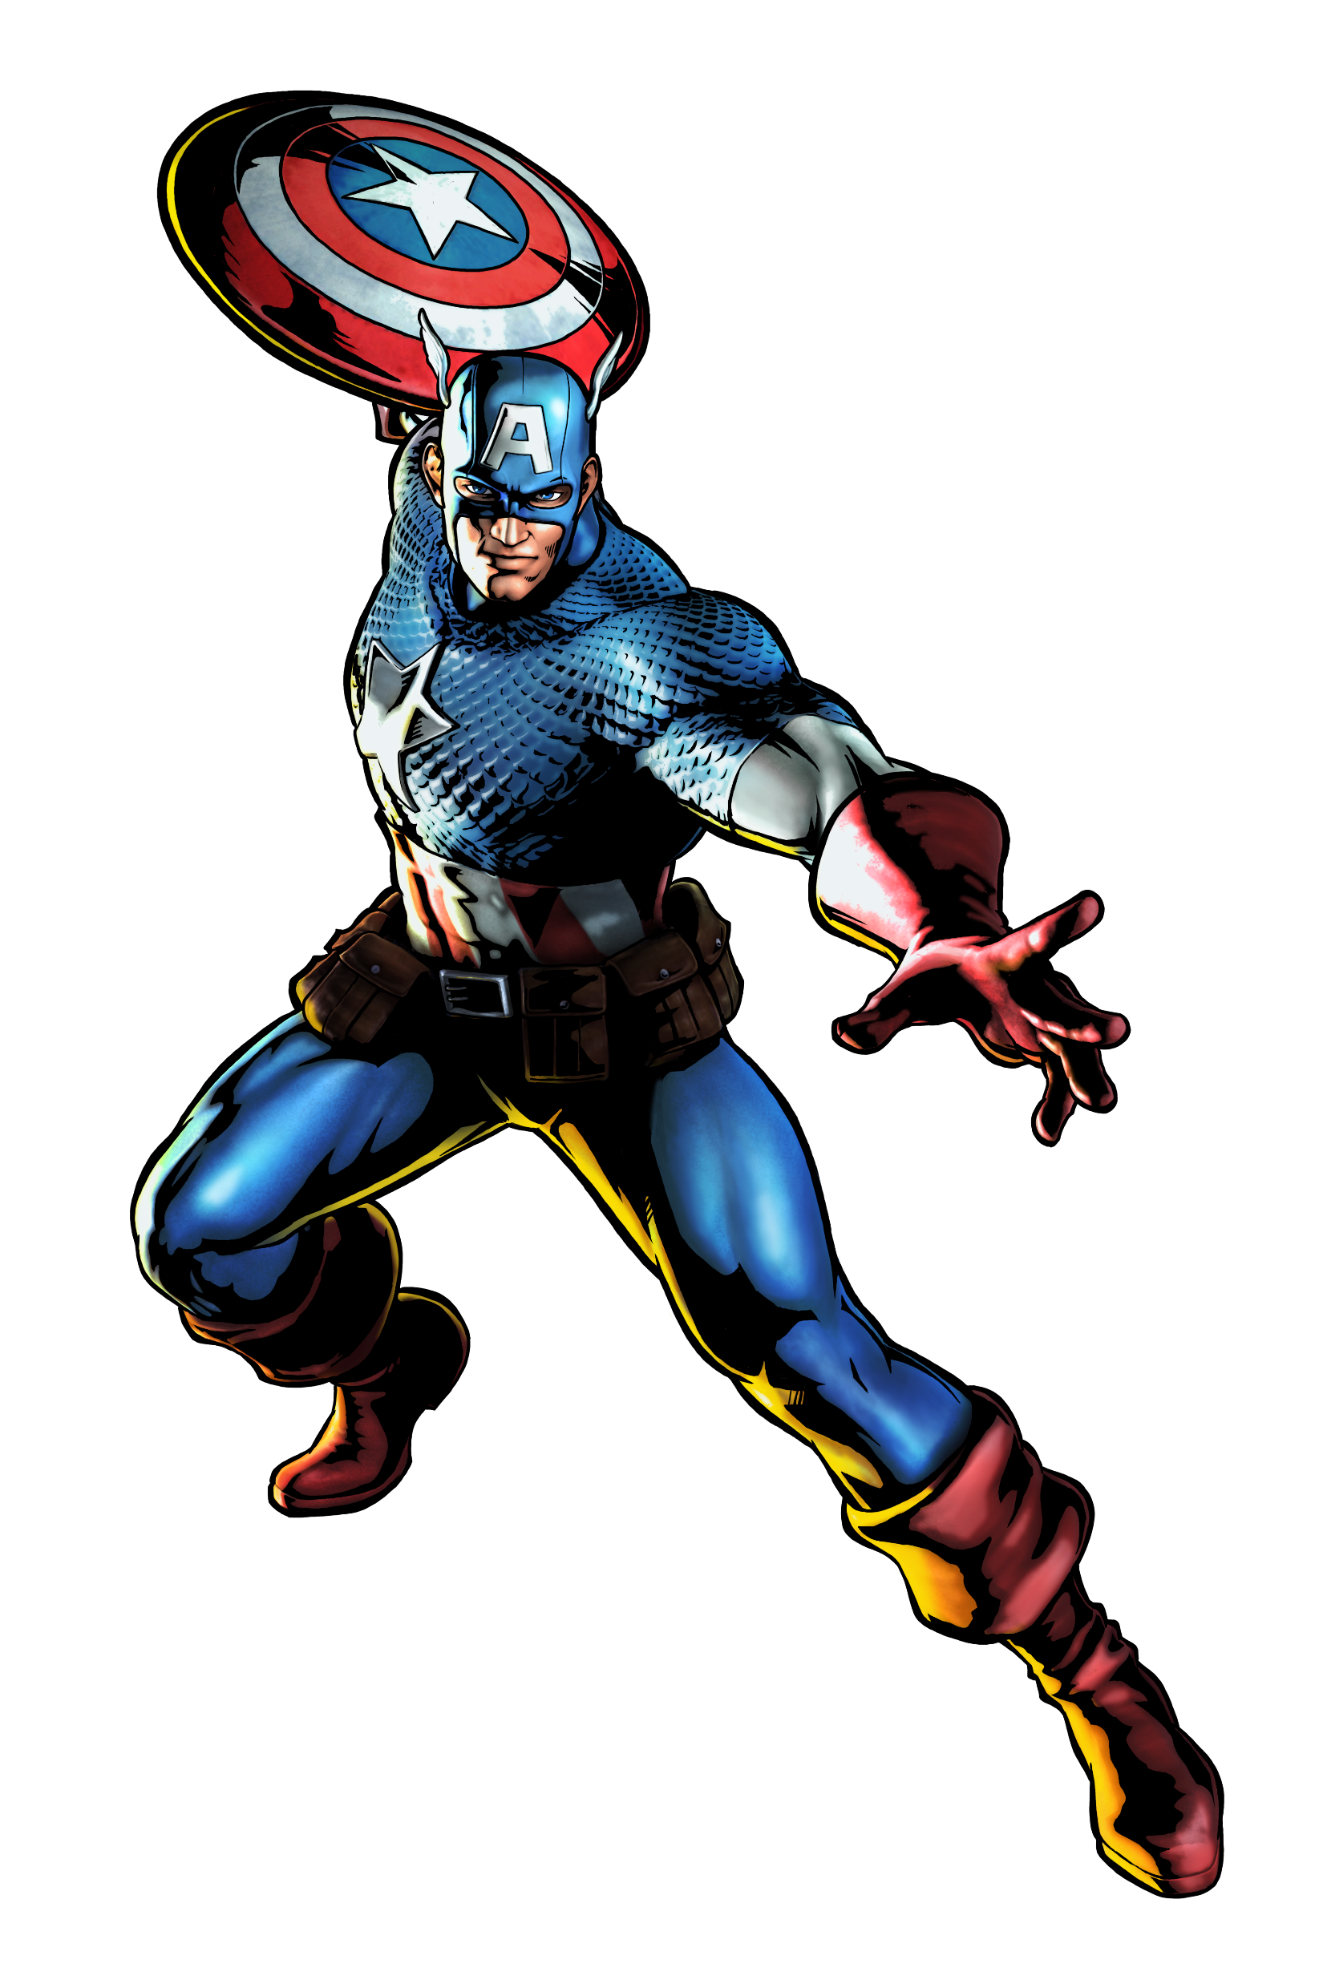
Team Introductions
Team Introductions
Zafer Jesri
Systems Engineer
Trevor Lay
Thermal Engineer
Bryson Peters
Fluids Engineer
Catherine Potts
Manufacturing Engineer
Dane Seal
Design Engineer
Trevor Lay

Slide 3
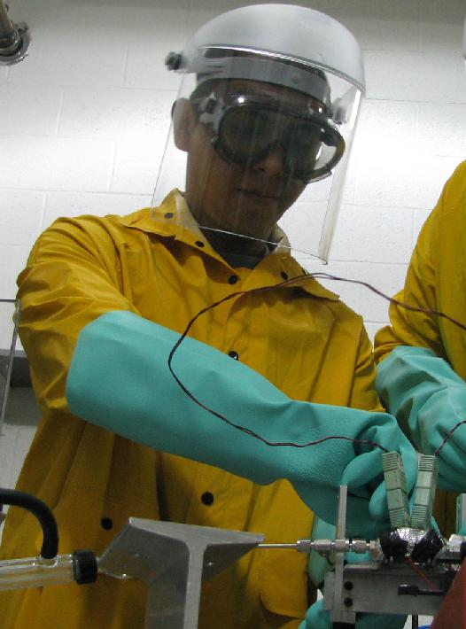
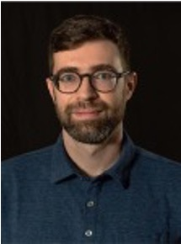
Sponsor and Advisor
Engineering Mentor
Juan Valenzeula
Aerospace Engineer
Academic Advisor
Mark Vanderlaan, Ph.D.
Head of Hybrid and Cryogenics Operations
Sponsor
National Aeronautics and Space Association
(NASA)
Trevor Lay

Slide 4

Project Objective
Create a support structure for a fiberoptic cable to measure cryogenic propellant levels.
Trevor Lay

Slide 5
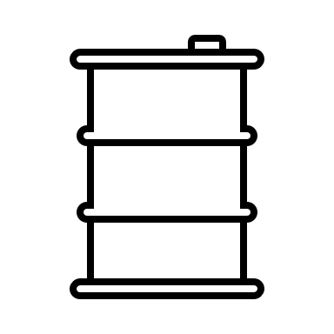

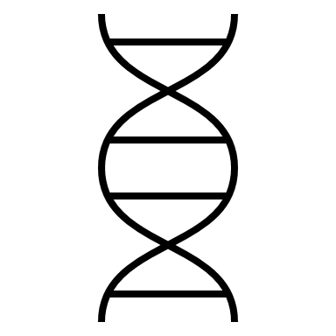
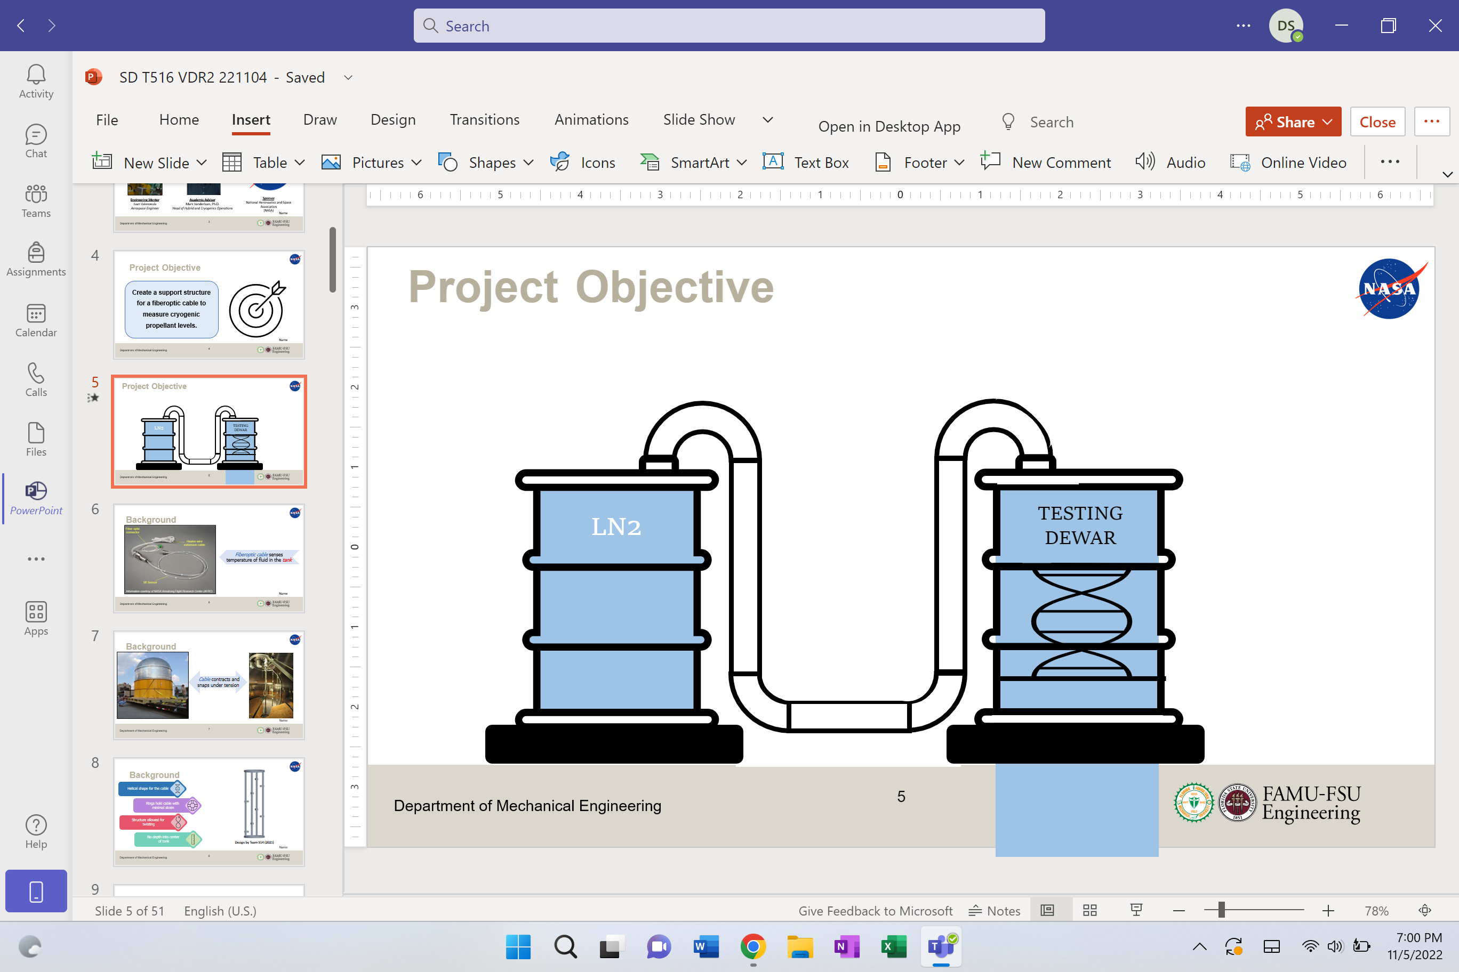
Project Objective
LN2
TESTING DEWAR
Temp = 77 K

Slide 6
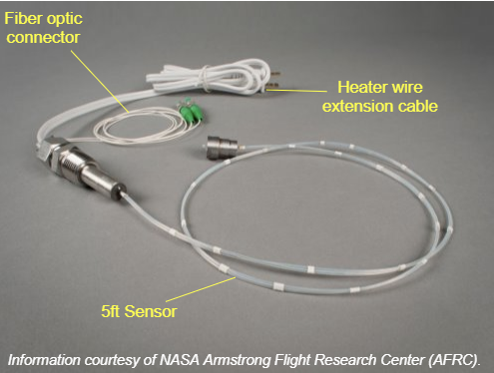
Background
Fiberoptic cable senses temperature of fluid in the tank
Trevor Lay
6

Slide 7
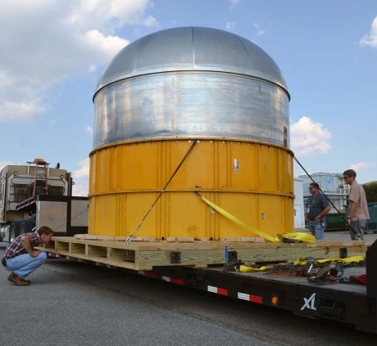
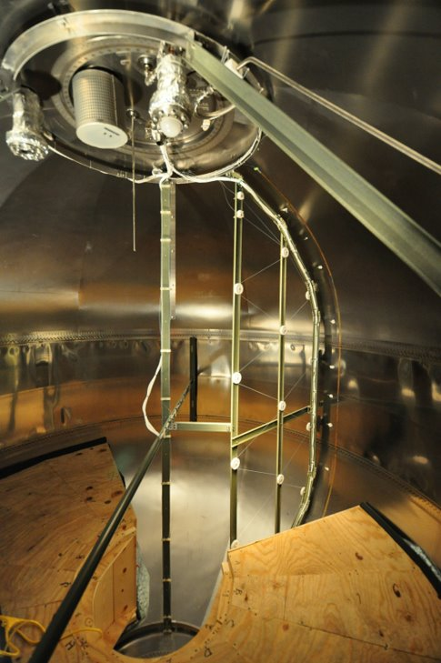
Background
Cable contracts and snaps under tension
Trevor Lay
7

Slide 8
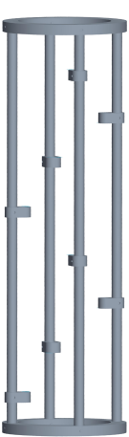
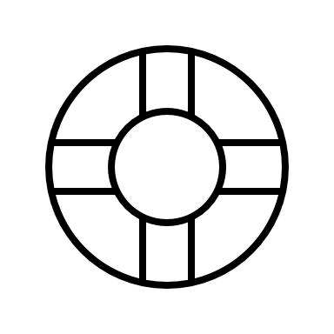


Background
Helical shape for the cable
Rings hold cable with
minimal strain
Structure allowed for
twisting
No depth into center
of tank
Design by Team 514 (2021)
Trevor Lay
8

Slide 9
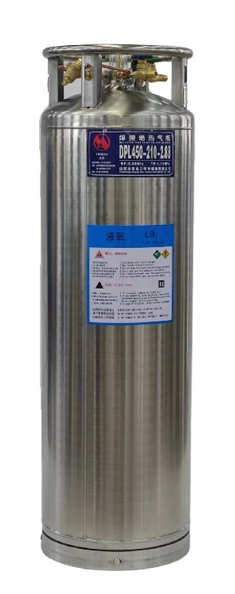
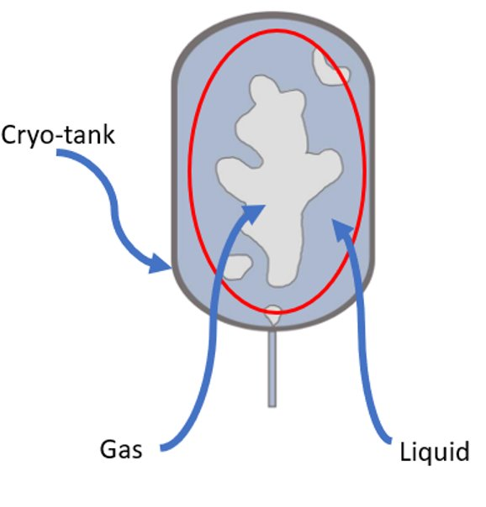
Assumptions
Testing will occur at the MAGLAB
Project Scope
Utilizing a dewar with liquid Nitrogen cryogenic testing fuel
Our structure will operate under zero-gravity conditions
The FOSS software is accurate and functional
Trevor Lay
9

Slide 10
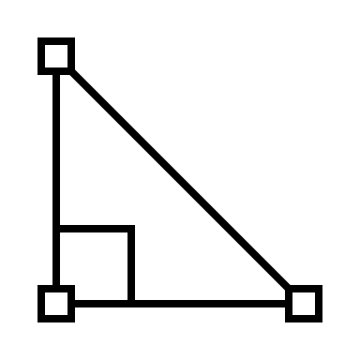




Customer Needs
Scalable Geometry
Withstands
Cryogenic Temperatures
Measures Fuel Levels
Interpret Sensor Readings
Trevor Lay
10

Slide 11
Functional Decomposition
Sensors
Structure
Power Source
Display Interface and Code
Trevor Lay
11

Slide 12






Targets and Metrics
We must ensure that the stress and strain incurred by the material at 77 K is not more than the material bounds.
The critical target for the display aspect is ensuring that our values are presented in a recognizable and presentable manner.
Sensors
The critical target dealing with the measurement system is the prevention of snapping or fracturing while exposed to LN2.
Display
POWER
Structure
Power source
supplies at least 12V​
Catherine Potts
12
Notes:
Target max stress and strain values for glass: 1KN/area, 3.5% strain

Slide 13
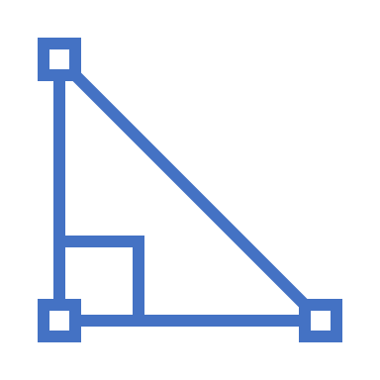


Targets
Design can be scaled to operate in tank of 17 m³
No taller than
0.66 m
Base is no wider than 0.36 m
Catherine Potts
13

Slide 14






Concept Generation
Brainstorm
Crap Shoot
Biomimicry
S.C.A.M.P.E.R.
Catherine Potts
14

Slide 15



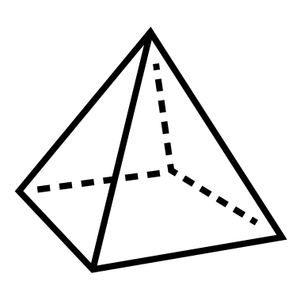

Medium Fidelity Concepts
Light dispersed in a prism that is then refracted through the liquid and gas, to determine the state of the propellant.
Lasers on either side of the tank that are aligned, the angle of misalignment corresponds to the index of refraction.
Radio frequency waves are sent to determine the
deflection at the base of the collector on the opposite side.
Use magnets on the outside of the tank to control a membrane that “combs” through the fluid and gas mixture.
Thermistors that are aligned in a circuit to determine the temperature of the propellant to determine the state.
21
27
31
93
103
Catherine Potts
15

Slide 16
High Fidelity Concepts
Concentric Helical Sweep Concept
Triangular Truss Concept
Honeycomb Support Concept
Catherine Potts
16

Slide 17

High Fidelity Concepts
Concentric Helical Sweep Concept
Triangular Truss Concept
Honeycomb Support Concept
Catherine Potts
17

Slide 18
High Fidelity Concepts
Concentric Helical Sweep Concept
Triangular Truss Concept
Honeycomb Support Concept
Catherine Potts
18

Slide 19
High Fidelity Concepts
Concentric Helical Sweep Concept
Triangular Truss Concept
Honeycomb Support Concept
Catherine Potts
19

Slide 20
Concept Selection
Binary
Pairwise
Comparison
House
Of
Quality
Analytical Hierarchy Process
Pugh
Chart
Final
Selection
Zafer Jesri
20

Slide 21
Binary Pairwise Comparison
Customer Needs | Score
Measure the Volume of Propellant | 6
Supports FOSS System | 5
Testable Under Cryogenic Conditions | 4
Scalable Design | 3
Fits Inside of the Dewar | 2
Ductile Material | 1
Low Conductivity Material | 0
Zafer Jesri
21

Slide 22
House of Quality
1. Distinguish if Fluid is Gas or Liquid
5. Relate Sensor Readings to Geometry
2. Withstand Cryogenic Conditions
6. Sensors Span Wide Range of the Tank
3. Measure the Fuel Level
7. Lay Foundation for Sensor Layout
4. Maintain Structural Integrity
Zafer Jesri
22

Slide 23
Pugh Chart
Customer Needs
Concept 1
Concept 21
- Withstand cryogenic conditions
- Distinguish if fluid is gas or liquid
- Lay foundation for sensor layout
+
+
S
S
+
-
Datum 1
Zafer Jesri
23

Slide 24
Analytical Hierarchy Process
1. Operates under Cryogenic Conditions
5. Fits inside the Dewar
2. Supports FOSS system
6. Scalable design
3. Measure the Volume of Propellant
7. Low conductivity material
4. Testable under Cryogenic Conditions
8. Ductile material
Zafer Jesri
24

Slide 25
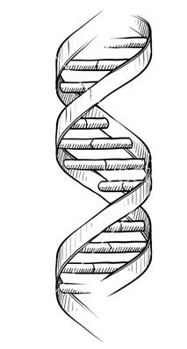
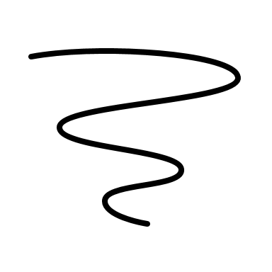

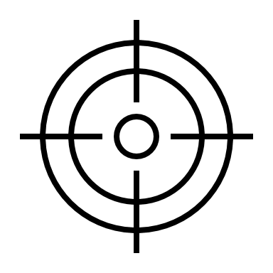



Final Selection
Nested helical sweeps of the cable
Attaching the support system to the dewar
Located in the center of the tank
Complications with open-dewar testing
Increased structural stability
Ensuring proper measurements are taken
Zafer Jesri
25

Slide 26





Future Work
Concept Design
and Analysis
Risk
Assessment
Bill of
Materials
Testing of
Support System
Spring
Project Plan​
Zafer Jesri
26

Slide 27






Summary
Zafer Jesri
27

Slide 28
Summary
The objective of our project is to create a support structure for a fiberoptic cable to accurately measure cryogenic
propellant levels.
Zafer Jesri
28

Slide 29
Summary
Assumptions:
Testing will occur at MagLab using a liquid nitrogen dewar; the
FOSS system is accurate.
Zafer Jesri
29

Slide 30
Summary
Customer needs: scalable geometry, withstanding cryogenic temperatures, measuring fuel levels and interpret the sensors
Zafer Jesri
30

Slide 31
Summary
The primary targets include measurement systems, structural integrity, power supply, and display.
Zafer Jesri
31

Slide 32
Summary
125 concepts generated from biomimicry, crapshoot, and SCAMPER.
Zafer Jesri
32

Slide 33
Summary
Binary Pairwise Comparison, Pugh Charts, House of Quality and Analytical Hierarchy tables used to select the best concept.
Zafer Jesri
33

Slide 34
Functional Decomp Backup

Slide 35
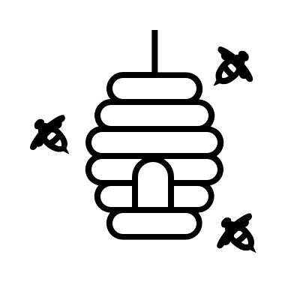
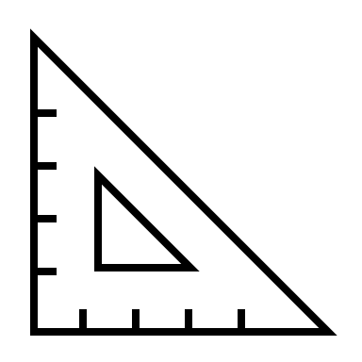
High Fidelity Concepts
High Fidelity Concepts
Vertical bars on the outside of a circular platform, with fiberoptic cables wrapped around every vertical bar in concentric helical sweeps.
Triangular truss system in a series of inverted structural orientations to create a reinforced triangular structural support system to hold the fiberoptic cable.
Use a honeycomb structure base to absorb shock and vibration utilizing small rings on the outside of the structure to hold the fiberoptic cable.
01
18
20
Catherine Potts
35

Slide 36
Concept Selection Backup

Slide 37
Detailed Math Backup

Slide 38
Standard Shapes
Summary Box
Text box 1
Outlined Text Box

Slide 39
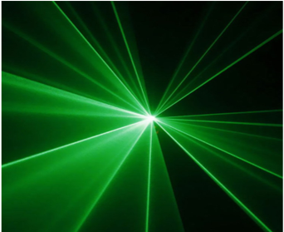
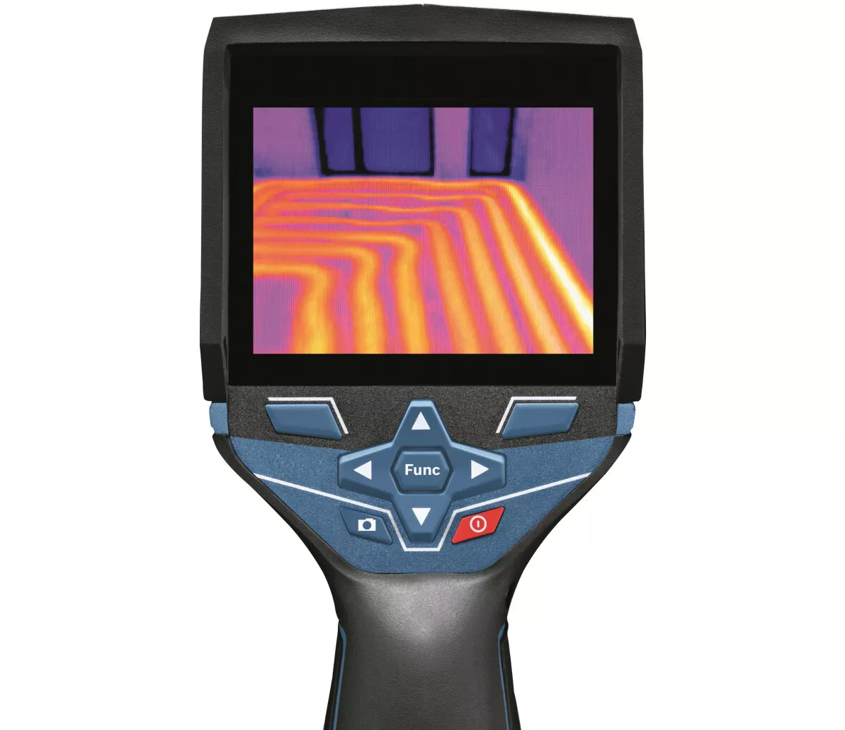

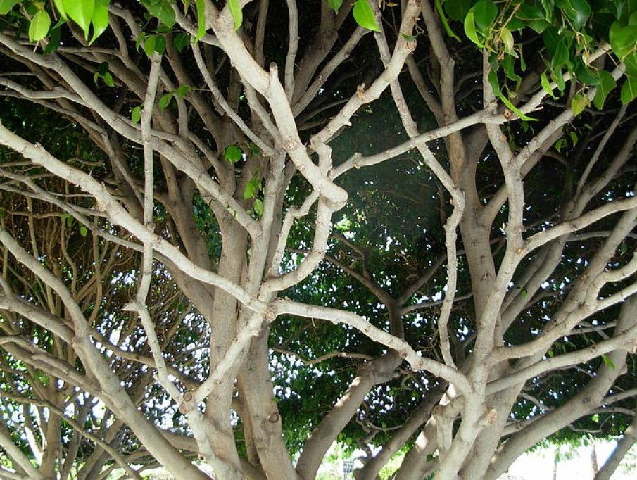
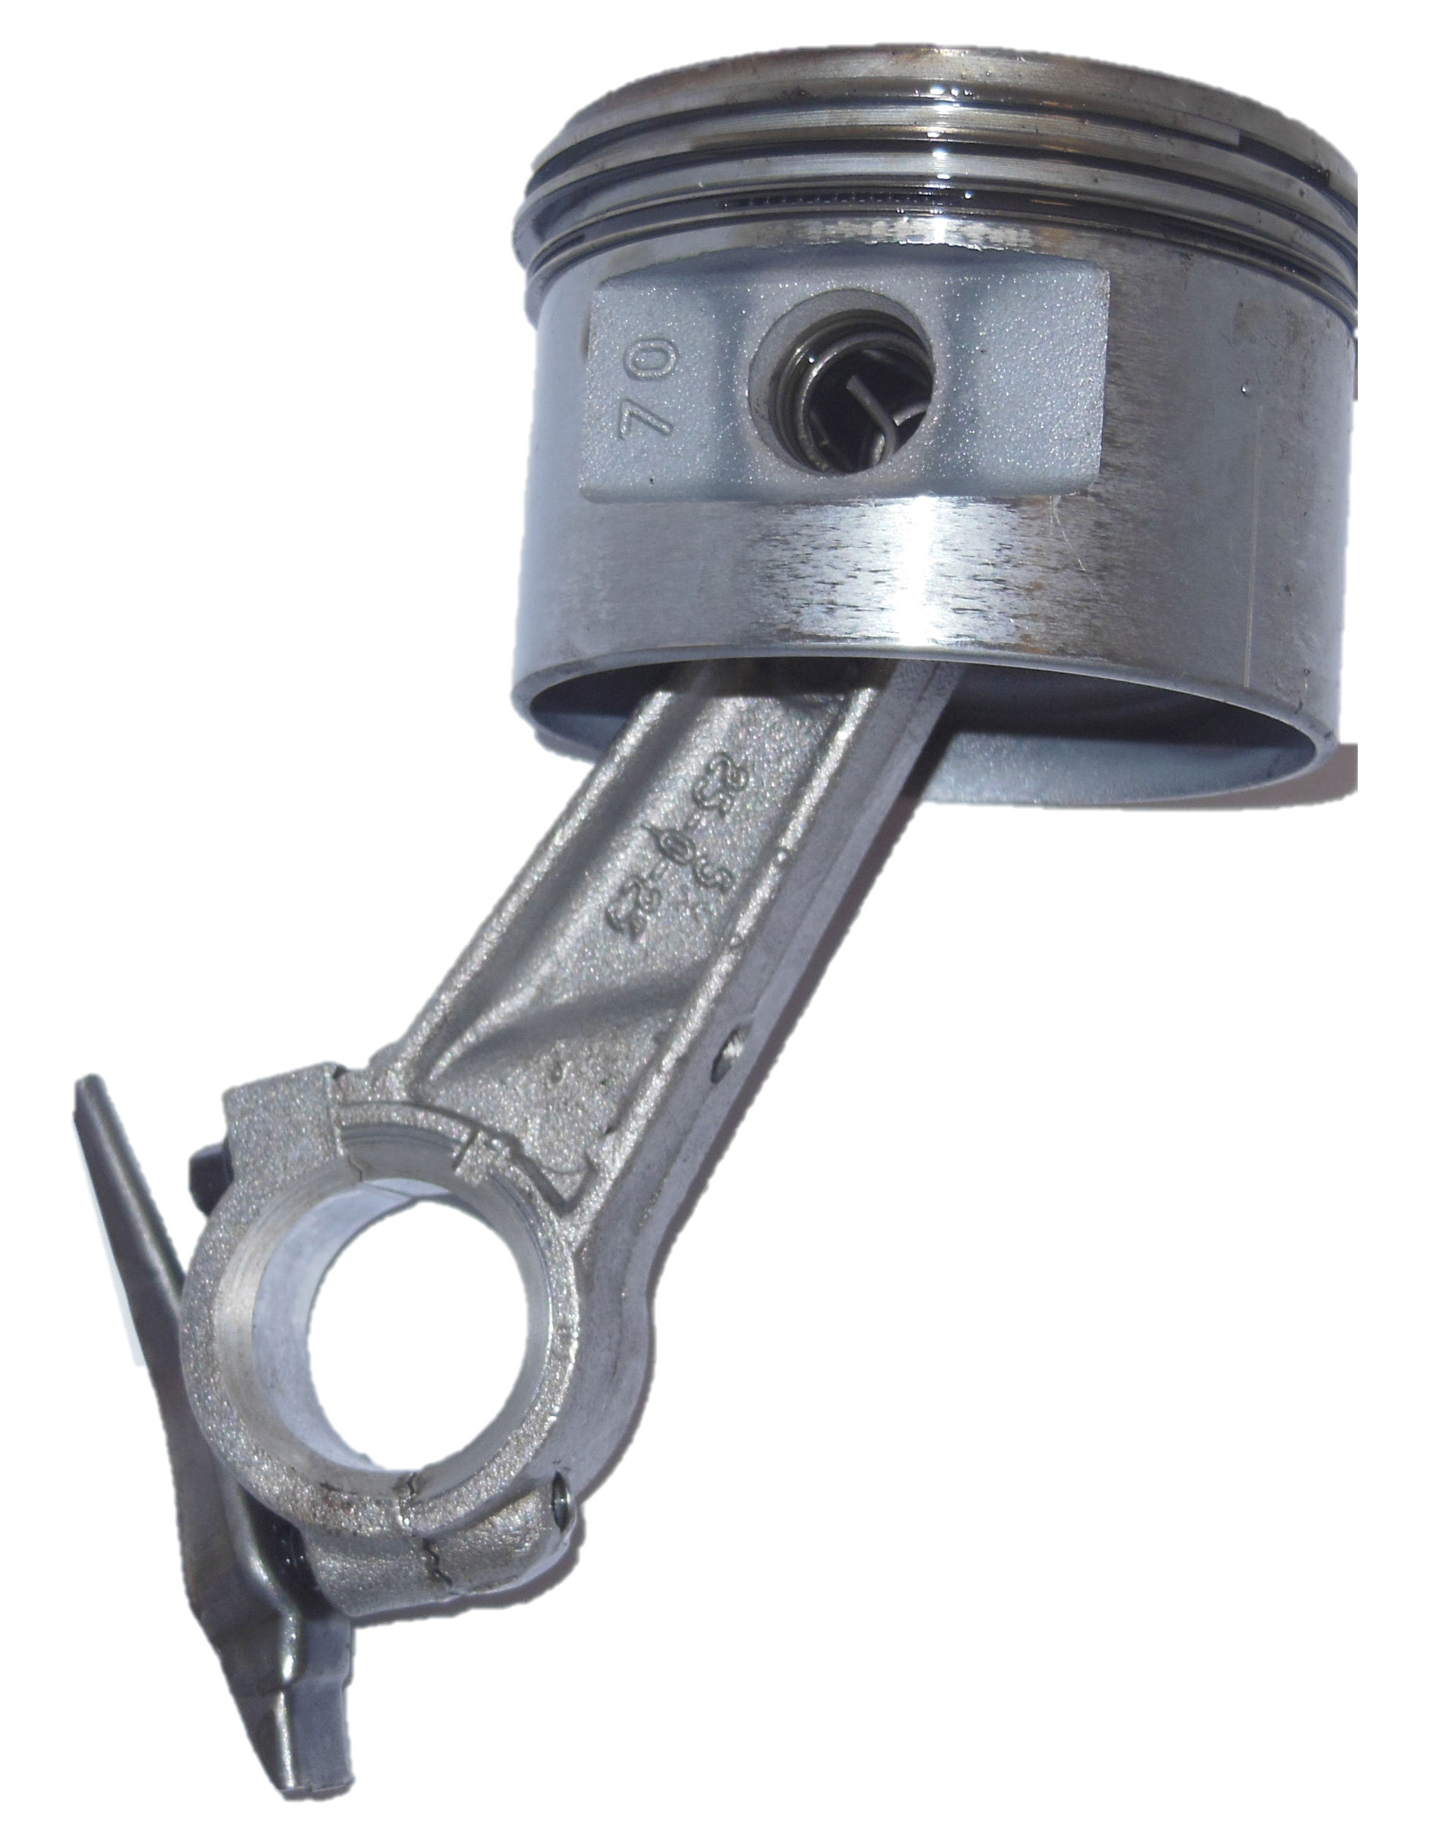
Do we still want this slide? Or nah
Name
39

Slide 40


Cool Shapes
Cable
Support Structure
Top View

Slide 41




Approved Logos

Slide 42
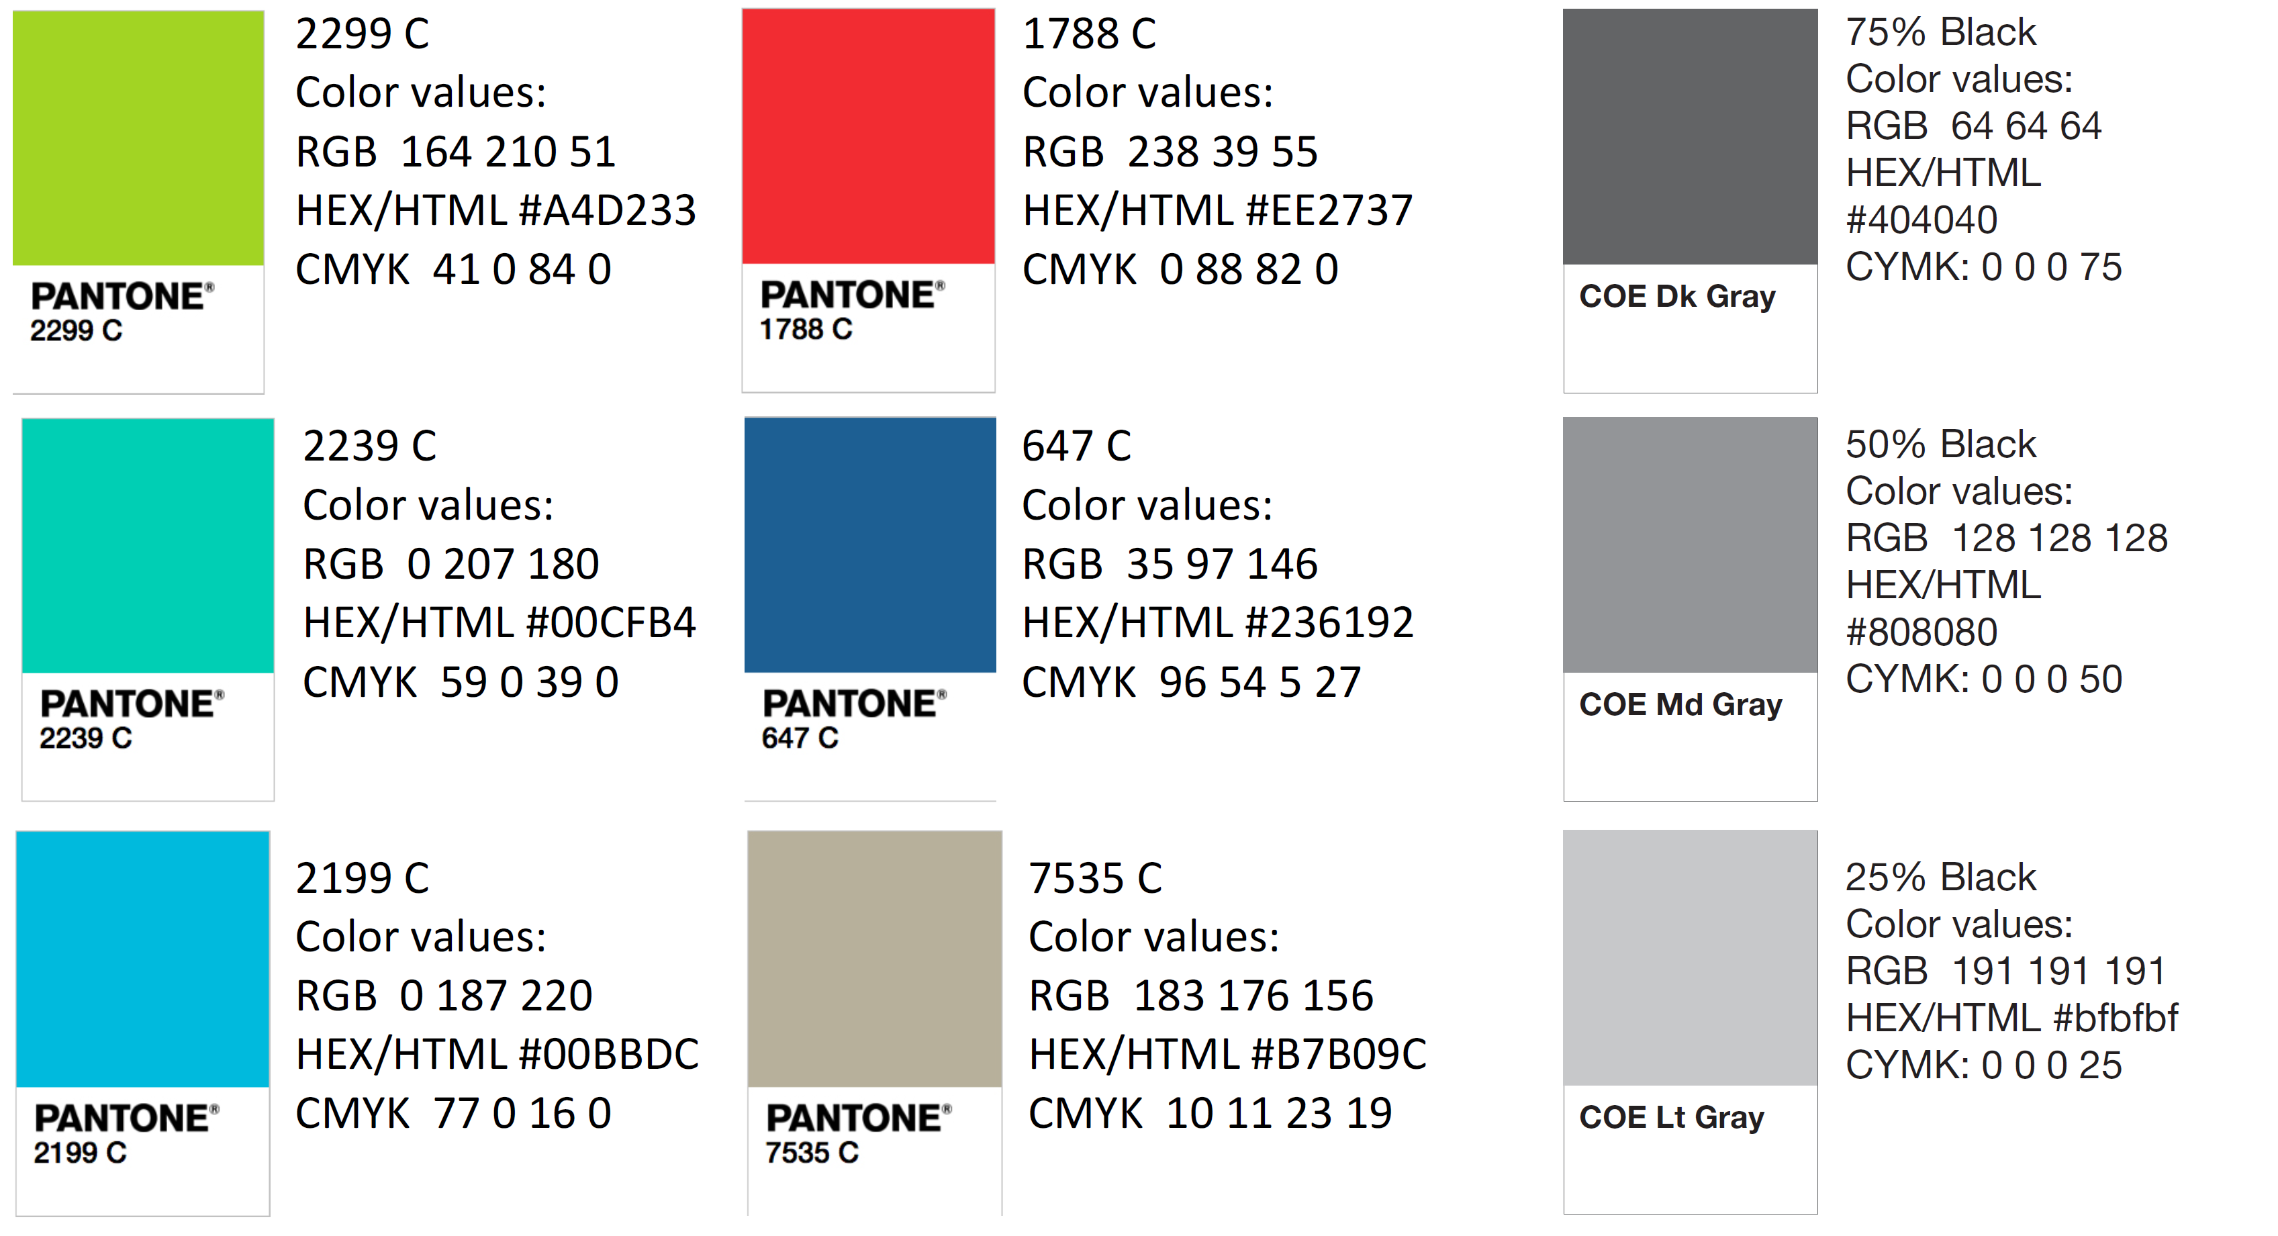
Color Palette

Slide 43
APA Tables
Category 1 | Category 2 | Category 3 | Category 4 | Category 5
Item 1
Item 2
Item 3
Item 4
 | Category 2 |  |  | Category 3
Category 1 | subcategory 1 | subcategory 2 |  | subcategory 1 | subcategory 2
Item 1
Item 2
Item 3
Item 4

